Slide 1
NGA 2014 Summer Workforce Meetings
Selected Handouts
“The Changing World of Credentials/Badges/Certifications.”
For further information, contact
Dr. Keith. W. Bird, Senior Policy Associate
Corporation for a Skilled Workforce
kbird@skilledwork.org
843-685-4249

Slide 2
Credentials: It’s all about Valuing Learning
Lumina defines high-quality credentials as degrees and certificates that have well-defined and transparent learning outcomes which provide clear pathways to further education and employment. All of these efforts are rooted in and serve to amplify two basic truths:
The first is that learning—all types of learning—can be objectively measured.
And the second is that these measurements are absolutely vital in ensuring the relevance and value of a college credential.
It's not so much what students know these days; rather, it's about mastering the skills required to constantly know more—and to use what we know. Students need to "learn how to learn.“ required to constantly know more—and to use what we know. Students need to "learn how to learn.”

Slide 3
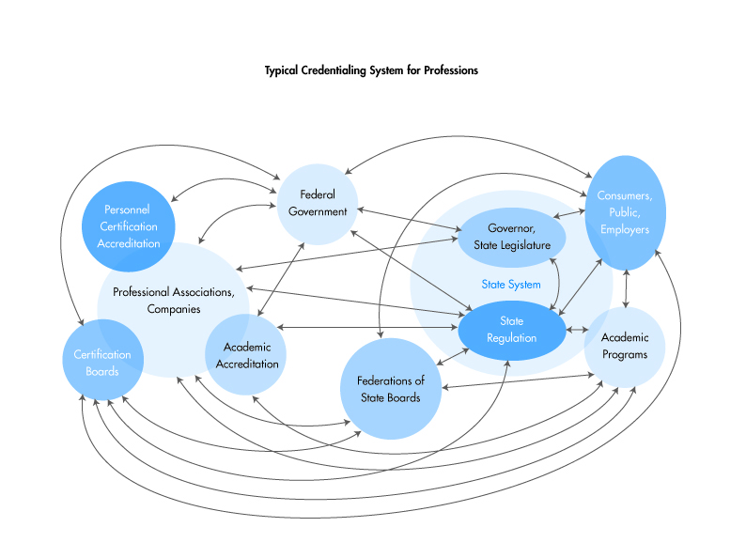
Credentialing System in the United States

Slide 4
Challenges: Credentials . . . and Majors/Occupations Matter
43% of licenses and certificates earn more than an Associates Degree
27% of licenses and certificates earn more than a Baccalaureate Degree
31% of Associate Degrees earn more than a Baccalaureate Degree
Source: Georgetown Center on Education and the Workforce
And what about other “Alternative Credentials” U. S. Census Study: Measuring Alternative Educational Credentials: 2012 (2014)

Slide 5
Key Challenges to Credentialing
The Proliferation of Certificates and Certifications (terminology chaos)
Lack of Understanding of “Alternative Credentials”
Credentials are not always transferrable across programs and geographies
Wide variance in quality of certificates and certifications/Inconsistent quality assurance mechanisms
Competencies (job tasks and knowledge, skills, abilities) not consistently defined
Many credentials are too expensive and are not always available in all locations
Confusion among certification, certificates and accreditation with stakeholders
No understanding of the relationship between certificates, certifications and degrees and how they relate to pathways/flow/Intra-profession and inter-professional mobility
Reliance on different forms of assessment
Lack of transparency, lack of portability and articulation
Mixed market value of credentials
Credentials can’t be used as proxies for competence

Slide 6
The U.S. Credentials Framework
(Being developed by CSW and CLASP with support
from Lumina Foundation)
The Credential Framework provides a comprehensive framework for understanding the types of learning associated with the diverse array of credentials in the U.S. and offers a unified way to depict levels of learning outcomes/competencies reflected in both degree and non-degree credentials. It aims to support integration, comparison and alignment across varied credentials and to value learning wherever it has occurred and allow students to “stack” credentials to advance in career pathways.

Slide 7
Credentials Framework: Connecting the Dots Among Quality Credentials
Credentials Framework: Connecting the Dots among Quality Credentials
DEGREES
CERTIFICATIONS
CREDENTIALS
FRAMEWORK
CERTIFICATES non-degree and degree, PS and other organizations
LICENSES
DIPLOMAS
Postsecondary
DIGITAL BADGES
APPRENTICESHIP
CREDENTIALS

Slide 8
Credentials Framework Complements Other Key Initiatives
Labor Market
Reference Instruments
(e.g., USDOL O*NET, Competency Frameworks, Job Profiling)
Credential Registry Framing
(e.g. GWU-ANSI)
Transcript Portfolios
(e.g., WICHE Interstate Passport)
Credit Definition
(e.g. Carnegie Unit rethinking)
Credentials
Framework
(Meta Framework)
Industry Sector
Credentials Alignment
(e.g., NNBIA Blueprint)
Higher Education
Degrees Alignment
(e.g., DQP, Tuning, Discipline & Field of Study Specific)
K-12 Education
(e.g., Common Core State Standards)
Career & Technical Education
(e.g. Career Clusters)
Competency-Based Post-Secondary Education Expansion
Factoring Competencies into Academic & Professional Accreditation
Prior Learning Assessment Expansion

Slide 9
Why is a U.S. Credential Framework Important?
A Credentials Framework based on outcomes based performance measures of learning (not time-based) promotes transparency, comparability and portability of credentials
Clear value propositions can and must be articulated for learners, employers, and educators from the creation of a unified Credentials Framework. Framing clear, compelling value propositions is essential to stakeholder adoption.
A unified Framework is essential to maximize opportunities for all learners. Labor market value is integral to definition of a quality “non-degree” credential.
Competencies within a framework need to include three core dimensions: knowledge, skills, abilities. The Credentials Framework needs multiple levels of competency to reflect the diversity of learning and complexity reflected by various credentials.
The Framework needs to reflect that credentials are acquired and used both in linear and non-linear ways. Credentialing in U.S. involves diverse organizations and approaches.

Slide 10
Institutional, State, Federal Policy Recommendations:
Begin a National Dialogue to establish a national competency-based framework for Postsecondary Education to establish learning outcomes for multiple levels of credentials with input from multiple participants, including education, workforce, and employer stakeholders
Create a National Clearinghouse for Credentials
Provide standard terminology and methodologies to document the development and documentation of standards for competency based qualifications and curricula (including PLA/ CTE credit transfer)
Create a central database with common terminology and ensure proper categorization of programs recognized by federal and state governments and industry with quality assurance mechanisms (e. g. third party validation and based on National/International Standards and Regulatory Standards)
Promote state & institutional policies & practices that:
Create a central database with common terminology
Preapprove equivalencies between credits & certifications
Streamline course approval
Promote co-enrollment/Advanced Standing
Develop “Pay for Performance” Strategies (e.g. provide incentives for accelerating time to credential through competency-based approaches)
Require/Scale Use of:
Competency-based assessments
Award of credit for prior learning
Articulation between credit and non-credit learning

Slide 11
Institutional, State, Federal Policy Recommendations:
Encourage Institutional, State, and Federal Policies that Support Innovation
Use FA experimental authority to test competency rather than semester-based Pell delivery mechanisms (including PLA)
Increase alignment and linkages between federal, state, and local public workforce systems, AE, and educational institutions in developing stackable credentials and career pathways
Establish linked goals among workforce and economic development and education stakeholders in key measureable metrics and report performance outcomes (e.g. X% increase in labor market validated credentials in critical industries)
Spread the message that a “college” education includes options other than a baccalaureate degree
Ensure that curricula reflects labor market needs and that students choose the right programs and credentials
Increase career navigation support and focus on labor market outcomes
Raise the bar for business engagement
Promote the joint establishment of rigorous competency/standards/curricula/credentials and quality assurance mechanisms between business and education (curriculum development)
Challenge employers to share ongoing responsibility for a competitive workforce and establishing meaningful curricula and credentials and utilizing credentials in HR and talent Development

